Slide 1
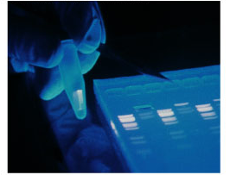
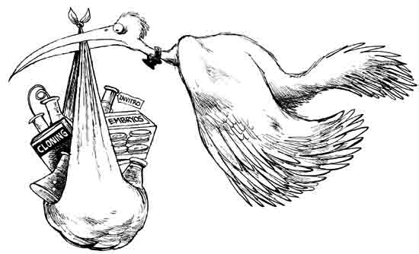
Biotechnology

Slide 2
Recombinant DNA
Taking DNA from two sources and combining then into one molecule.
  Occurs naturally by:
    viral transduction
    bacterial transformation
    bacterial conjugation
Biotechnology (genetic engineering)
  Engineering genes in the Lab

Slide 3
Biotechnology
Electrophoresis
Recombinant Technology
Polymerase Chain Reaction
Transgenics/GMO’s
Cloning
Understand the basics of each process

Slide 4
Many uses of restriction enzymes…
Besides cloning DNA….
Compare DNA sequences from different people or organisms!
    forensics
    medical diagnostics
    paternity
    evolutionary relationships
  RFLP’s – Restriction Fragment
  Length Polymorphisms
    Humans are 99% the same genetically, this is what makes you different from each other

Slide 5
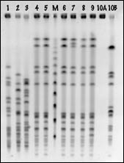
Comparing Cut Up DNA:
How can we compare DNA fragments?
  separate fragments by size
How do we separate DNA fragments?
  Use the technique of
  Gel Electrophoresis!

Slide 6
Gel Electrophoresis
DNA moves through electrical agar
  DNA is negatively charged so it is attracted to positive
  Fragment size affects how far it travels
      small pieces travel farther (less bulk)
      large pieces travel slower & lag behind
DNA → → → → → → →
–
+
“swimming through Jello”

Slide 7
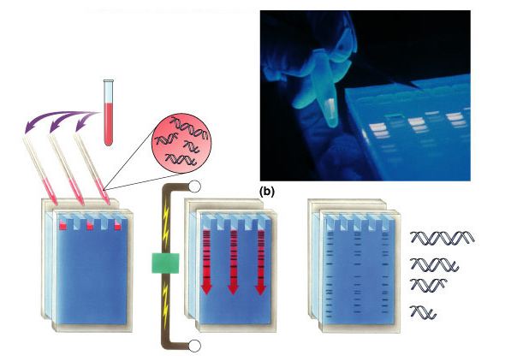
Gel Electrophoresis
DNA &
restriction enzyme
-
wells
longer fragments
power
source
gel
shorter fragments
+
completed gel

Slide 8
Uses: Evolutionary relationships
Comparing similar bands can show common ancestry
turtle
snake
rat
squirrel
fruitfly
–
1
2
3
4
5
1
2
3
4
5
DNA
↓
+

Slide 9
Uses: Medical diagnostic
Comparing normal allele to disease allele
chromosome
with normal
allele 1
chromosome with
disease-causing
allele 2
allele 1
allele 2
–
DNA
↓
Example: test for Huntington’s disease
+

Slide 10
Uses: Forensics
Comparing DNA sample from crime scene with suspects & victim
suspects
crime
scene
sample
S1
S2
S3
V
–
DNA
↓
Remember it’s the RFLP’s that make our fragments different and UNIQUE!
+

Slide 11
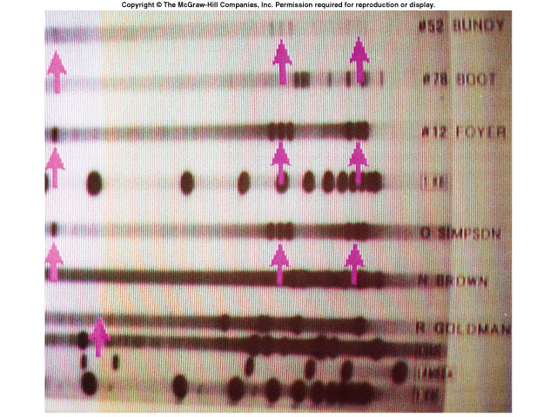
Electrophoresis use in forensics
Evidence from murder trial
  Do you think the suspect is guilty?
blood sample 1 from crime scene
blood sample 2 from crime scene
blood sample 3 from crime scene
“standard”
blood sample from suspect
OJ Simpson
blood sample from victim 1
N Brown
blood sample from victim 2
R Goldman
“standard”

Slide 12
Uses: Paternity
Who’s the father?
–
Mom
F1
F2
child
DNA
↓
+

Slide 13
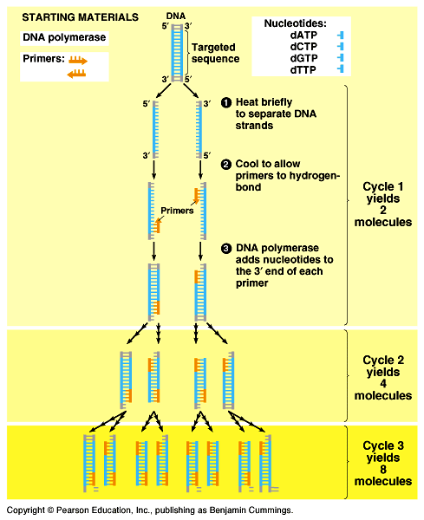
Polymerase Chain Reaction
DNA copy machine!
Use bacterial enzyme: Taq DNA polymerase
  Heat extreme tolerance

Slide 14
PCR process
What do you need to do?
  in tube: DNA, DNA polymerase enzyme, primer, nucleotides
  denature DNA: heat (90°C) DNA to separate strands
  anneal DNA: cool to hybridize with primers & build DNA (extension)
What does 90°C
do to our
DNA polymerase?

Slide 15

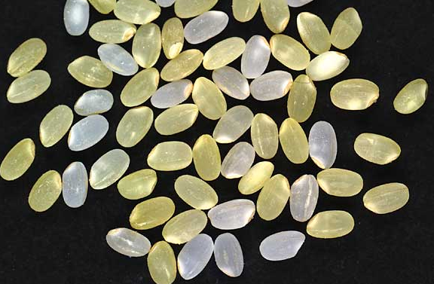
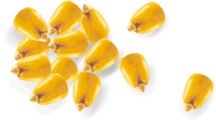
Transgenics – organisms with foreign DNA
Genetically modified organisms (GMO)
  Uses include: to produce pharmaceuticals, increase resistance to disease, increase nutrient density
    Protect crops from insects: BT corn
      corn produces a bacterial toxin that kills corn borer (caterpillar pest of corn)
    Extend growing season: fishberries
      strawberries with an anti-freezing gene from flounder
    Improve quality of food: golden rice
      rice producing vitamin A
      improves nutritional value
Notes:
For example, a transgenic rice plant has been developed that produces yellow grains containing beta-carotene.
Humans use beta-carotene to make vitamin A.
Currently, 70% of children
under the age of 5 in
Southeast Asia are deficient
in vitamin A, leading to
vision impairment and
increased disease rates.

Slide 16
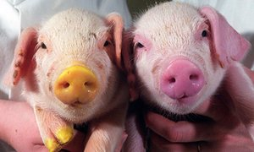
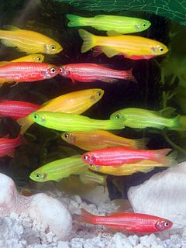
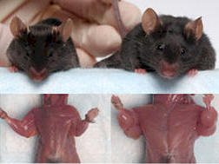
Transformed Eukaryotes
Jelly fish “GFP”
Myostatin protein modification
Indicators of aquatic pollutants

Slide 17
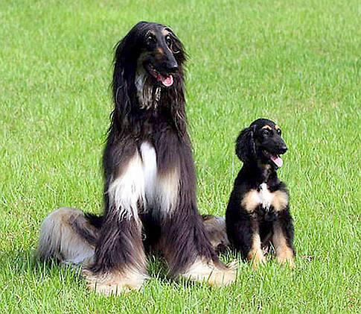
Clone
A genetically identical organism or a group of cells derived from a single cell
Major goal of cloning:
The production of stem cells!

Slide 18
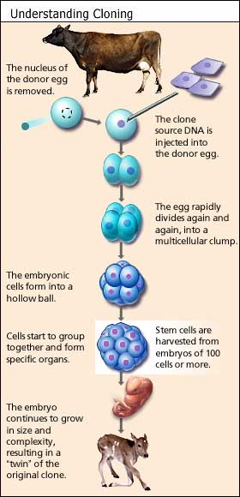
Cloning Process
Take the nucleus from a somatic (body) cell donor
Obtain unfertilized egg and remove its nucleus
Transfer nucleus from somatic cell into egg cell.
Provide needed proteins/signals to begin division
Implant embryo into uterus to continue with development

Slide 19
Newest Gene Editing Technology
CRISPR Cas9
  Disease cures?
  Designer babies?
  Video #1 – Bozeman
  Video #2 – Ted Talk

